Slide 1
CSC111
Introduction to Computer Science
Course Instructors:
Prof. B. S. Aribisala
Dr. U. C. Ogude
Department of Computer Science
Lagos State of University

Slide 2
Introduction to Software and Programming Languages
System Software
Operating Systems
Types of Operating Systems
Language Translators
Utility Software
Application Software
Word Processing Packages
Spread sheet Packages
Graphic Packages
Database Packages
Computer Languages
Machine Languages
Low-Level Languages
High-Level Languages
Desktop Publishing Packages
Games Packages
Communication Packages
User Programs
Integrated Packages

Slide 3
Computer Languages
Computer language or programming language is a coded syntax used by computer programmers to communicate with a computer.
Computer language establishes a flow of communication between software programs.
The language enables a computer user to dictate what commands the computer must perform to process data.
These languages can be classified into following categories, see the diagram.

Slide 4
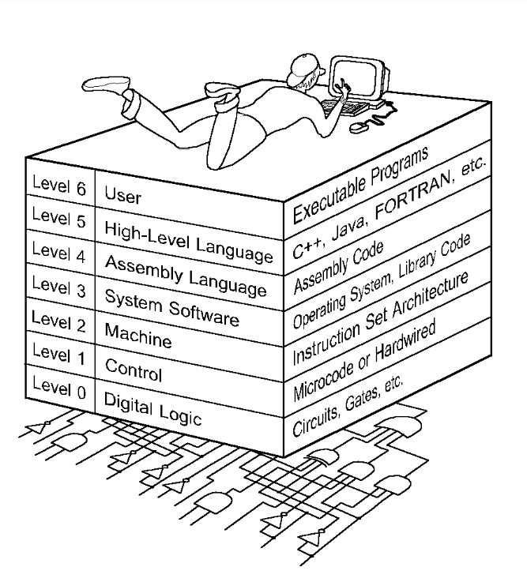

Slide 5
Level 6: The User Level
  Program execution and user interface level.
  The level with which we are most familiar.
Level 5: High-Level Language Level
  The level with which we interact when we write programs in languages such as C, Pascal, Lisp, and Java.
Level 4: Assembly Language Level
  Acts upon assembly language produced from Level 5, as well as instructions programmed directly at this level.
Level 3: System Software Level
  Controls executing processes on the system.
  Protects system resources.
  Assembly language instructions often pass through Level 3 without modification.

Slide 6
Level 2: Machine Level
  Also known as the Instruction Set Architecture (ISA) Level.
  Consists of instructions that are particular to the architecture of the machine.
  Programs written in machine language need no compilers, interpreters, or assemblers.
Level 1: Control Level
  A control unit decodes and executes instructions and moves data through the system.
  Control units can be microprogrammed or hardwired.
  A microprogram is a program written in a low-level language that is implemented by the hardware.
  Hardwired control units consist of hardware that directly executes machine instructions.
Level 0: Digital Logic Level
  This level is where we find digital circuits (the chips).
  Digital circuits consist of gates and wires.
  These components implement the mathematical logic of all other levels.

Slide 7
Computer Languages
Machine Language
  Uses binary code
  Machine-dependent
  Not portable
Assembly Language
  Uses mnemonics
  Machine-dependent
  Not usually portable
High-Level Language (HLL)
  Uses English-like language
  Machine independent
  Portable (but must be compiled for different platforms)
  Examples: Pascal, C, C++, Java, Fortran, . . .

Slide 8
Machine Language
The representation of a computer program which is actually read and understood by the computer.
  A program in machine code consists of a sequence of machine instructions.
Instructions:
  Machine instructions are in binary code
  Instructions specify operations and memory cells involved in the operation
Example:
Operation | Address
0010 | 0000 0000 0100
0100 | 0000 0000 0101
0011 | 0000 0000 0110

Slide 9
Assembly Language
A symbolic representation of the machine language of a specific processor.
Is converted to machine code by an assembler.
Usually, each line of assembly code produces one machine instruction (One-to-one correspondence).
Programming in assembly language is slow and error-prone but is more efficient in terms of hardware performance.
Mnemonic representation of the instructions and data
Example:
  Load Price
  Add Tax
  Store Cost

Slide 10
High-level language
A programming language which use statements consisting of English-like keywords such as "FOR", "PRINT" or “IF“, ... etc.
Each statement corresponds to several machine language instructions (one-to-many correspondence).
Much easier to program than in assembly language.
Data are referenced using descriptive names
Operations can be described using familiar symbols
Example:
Cost := Price + Tax

Slide 11
Syntax & Semantics
Syntax:
  The structure of strings in some language. A language's syntax is described by a grammar.
  Examples:
    Binary number
      <binary_number> = <bit> | <bit> <binary_number>
      <bit> = 0 | 1
    Identifier
      <identifier> = <letter> {<letter> | <digit> }
      <letter> = a | b | . . . | z
      <digit = 0 | 1 | . . . | 9
Semantics:
  The meaning of the language

Slide 12
Syntax and Grammars
Syntax descriptions for a PL are themselves written in a formal language.
  E.g. Backus-Naur Form (BNF)
The formal language is not a PL but it can be implemented by a compiler to enforce grammar restrictions.
Some PLs look more like grammar descriptions than like instructions.

Slide 13
Compilers and Programs
Compiler
  A program that converts another program from some source language (or high-level programming language / HLL) to machine language (object code).
  Some compilers output assembly language which is then converted to machine language by a separate assembler.
  Is distinguished from an assembler by the fact that each input statement, in general, correspond to more than one machine instruction.

Slide 14
Compilation into Assembly L
Assembly Language
Source
Program
Compiler
Assembly Language
Machine
Language
Assembler
Notes:
Instead of to ML
Facilitates debugging
Isolates compiler from changes in format of ML (new OS)
Only assembler must be changed!

Slide 15
Compilers and Programs
Source program
  The form in which a computer program, written in some formal programming language, is written by the programmer.
  Can be compiled automatically into object code or machine code or executed by an interpreter.
  Pascal source programs have extension ‘.pas’

Slide 16
Compilers and Programs
Object program
  Output from the compiler
  Equivalent machine language translation of the source program
  Files usually have extension ‘.obj’
Executable program
  Output from linker/loader
  Machine language program linked with necessary libraries & other files
  Files usually have extension ‘.exe’

Slide 17
What is a Linker?
A program that pulls other programs together so that they can run.
Most programs are very large and consist of several modules.
Even small programs use existing code provided by the programming environment called libraries.
The linker pulls everything together, makes sure that references to other parts of the program (code) are resolved.

Slide 18
Running Programs
Steps that the computer goes through to run a program:
Memory
Machine language program (executable file)
C P U
Input Data
Data entered during execution
Computed results
Program Output

Slide 19
Program Execution
Steps taken by the CPU to run a program (instructions are in machine language):
  Fetch an instruction
  Decode (interpret) the instruction
  Retrieve data, if needed
  Execute (perform) actual processing
  Store the results, if needed

Slide 20
Summary of Programming Languages
Fourth
  Even easy for non-programmers
  Tell what to do, not how to do it
  Focus, Powerhouse
Visual Programming Languages
  Point-and-click
  Drag-and-drop
  Useful for user interfaces
  Visual Basic, Visual C++
Object-oriented Languages
  Objects contain data, methods to operate data
  C++, Java

